Slide 1
Microsoft Purview
Comprehensive solutions to help govern, protect, and manage your data estate

Slide 2
How and when to use this presentation
This presentation is intended to provide a “Level 100” discussion of the Microsoft perspective on data governance and compliance and what our Microsoft Purview solutions are.
This presentation can be used to set the stage for the Level 200 presentations that dig into the platform areas.
Account Executive and SSP roles should feel comfortable with the depth of the content in this deck.
Please hide any slides you are not interested in delivering.
Additional resources, including sample deliveries and demo resources, can be found on the Security Hub.

Slide 3

Data usage is evolving and complex, moving outside of the traditional borders of business
Tablets
OS
Phones
Desktops
OS
Notes:
Data has become the lifeblood of every business, but with the shift to hybrid work and unprecedented levels of digital transformation, an organization’s data now lives outside of the traditional borders of business.

Slide 4
Organizations lack visibility into their data estate
Tablets
OS
Phones
Desktops
OS
Year over year, the amount of data available doubles
93% of data within an organization is dark
Notes:
Over 30% of decision makers don’t know where or what their sensitive business-critical data is, making it nearly impossible for organizations to protect that data, close exposure gaps, comply with regulatory requirements, or even manage access controls.
For data to fuel digital transformation, it must be readily discoverable, understandable, high quality, accessible and used in compliance with corporate, regulatory, privacy, risk and ethical standards. Considering over 93% of data within an organization is dark, customers are faced with solving an immediate need to cull the data surface area to protect more effectively against leaks or breaches.

Slide 5
The landscape is fragmented, creating risks
Tablets
OS
Phones
Desktops
OS
Exposure gaps
Missed regulatory requirements
Impeded digital transformation
Failed audits
Brand reputation at risk
Notes:
Not only is this data across a range of systems and applications, but it is also subject to rapidly evolving global regulations.

Slide 6

It’s challenging to find a solution that integrates with hybrid environments
90%
80%
of organizations are multi-cloud
of decision makers have purchased multiple products to meet compliance and data-protection needs
80%
find it hard to manage fragmented compliance and risk related solutions
A majority have purchased 3+ products
Notes:
The market has responded with dozens of products that address fragments of the data governance and compliance landscape, forcing Chief Data, Security, Compliance, and Legal Officers to stitch together a patchwork of solutions that don’t work together, expose infrastructure gaps and are costly and complex to manage. In fact, a recent survey of decision-makers showed that to meet their compliance and data-protection needs, almost 80% had purchased multiple products, and a majority had purchased 3 or more.² It’s not just more work; it’s also ineffective. Security outcomes are worse. Audits are failed. Legal cases lost. Brand reputation damaged.
HOOK: WHAT IF YOU COULD SIMPLIFY YOUR JOURNEY TO DATA SECURITY CONVERGENCE?

Slide 7
Microsoft Purview Comprehensive solutions to help govern, protect and manage your data estate
Understand & govern data
Manage visibility and governance of data assets across your environment
Safeguard data, wherever it lives
Protect sensitive data across clouds, apps, and devices
Improve risk & compliance posture
Identify data risks and manage regulatory compliance requirements
Microsoft ecosystem
Support for multi-cloud, hybrid, SaaS data | Third-party/partner ecosystem
Notes:
Introducing Microsoft Purview!
To help organizations govern and protect data across their multi-cloud, multi-platform data environment, while meeting the compliance requirements they are subject to, we are announcing Microsoft Purview. Microsoft Purview is a comprehensive set of solutions to help govern, protect, and manage your data estate.
Microsoft Purview unifies information protection, data governance, risk management, and compliance solutions so that customers can manage their data all from one place. Now, they can leverage that visibility across their environment to help close exposure gaps, simplify tasks through automation, stay up-to-date with regulatory requirements, and keep their most important asset, data, safe.

Slide 8
Microsoft Purview brings together solutions from our compliance and data governance portfolios
Risk & compliance
For risk, compliance, and legal teams
Microsoft Purview
Data Map
Data Catalog
Data Estate Insights
Information Protection
Data Loss Prevention
Data Lifecycle Management
Data Connectors
Insider Risk Management
eDiscovery
Audit
Records Management
Communication Compliance
Compliance Manager
Unified data governance
For data consumers, data engineers, data officers
Notes:
With Microsoft Purview we bring together compliance and data governance
The risk and compliance portfolio joins with our unified data governance

Slide 9
Understand and govern data Manage visibility and governance of data assets across your environment

Slide 10
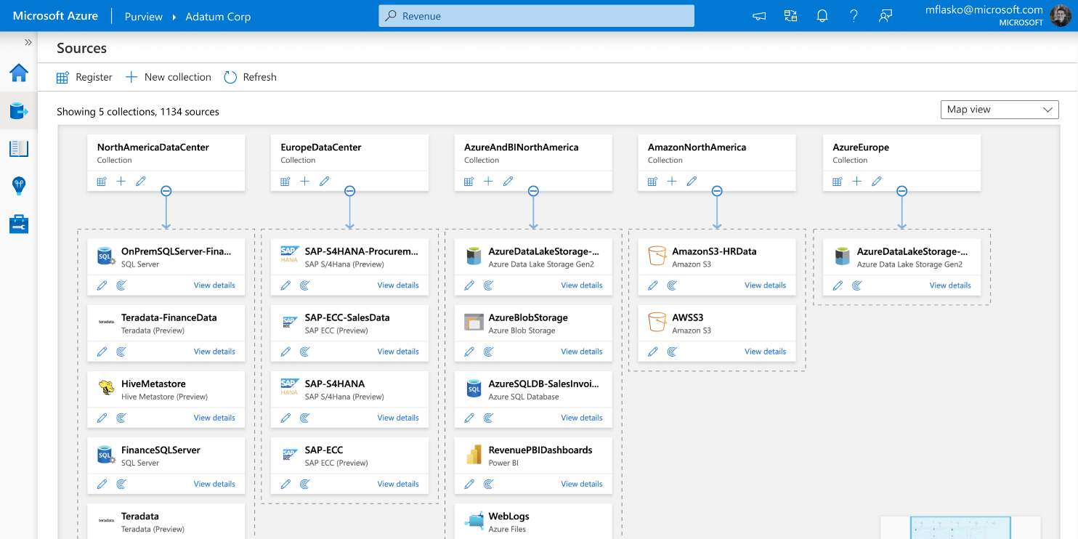

Microsoft Purview Data Map Unify and make data meaningful across your environment
Graph describes the data assets and their relationships across your data estate
Automated data scanning, classification and lineage extraction of hybrid data stores
200+ built-in data classifiers
Support for 35 data sources and growing

Slide 11
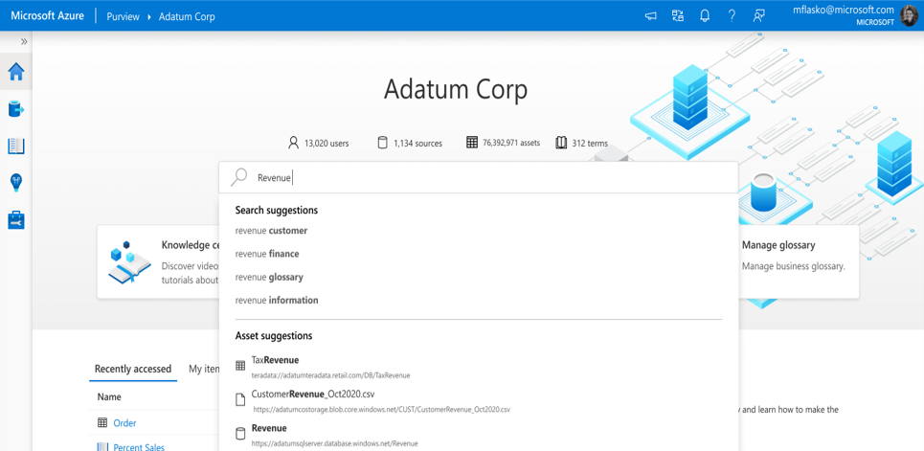
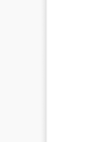
Microsoft Purview Data Catalog Enable effortless discovery of trusted data
Search, browse, and curate data
Intelligent recommendations
Lineage visualization

Slide 12
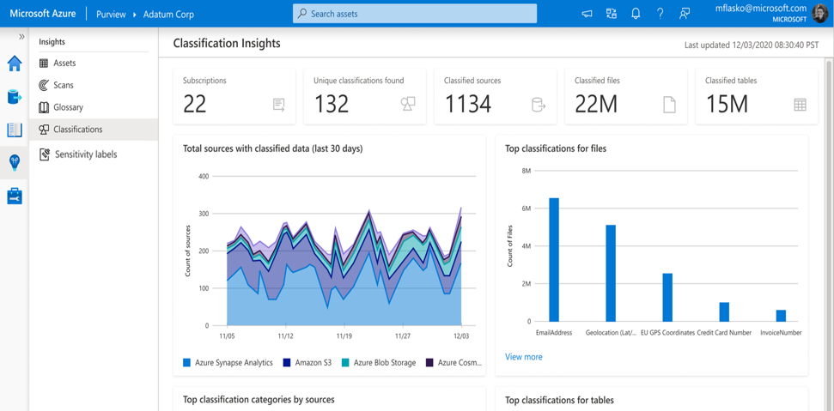
Microsoft Purview Data Estate Insights Gain a bird’s-eye view of your data landscape
Data asset distribution
Data scanning coverage
Business glossary utilization

Slide 13
Safeguard data, wherever it lives Protect sensitive data across clouds, apps, and devices

Slide 14

Top data security concerns
Data security incidents are widespread
83%
of organizations experience more than one data breach in their lifetime¹
Malicious insiders account for 20% of data breaches, adding to costs
$4.18M
Average cost of data breach with a malicious insider²
Organizations are struggling with a fragmented solution landscape
of decision makers purchased multiple products to meet compliance and data protection needs³
80%
Cost of a Data Breach Report 2022, IBM
Cost of a Data Breach Report 2022, IBM
February 2022 survey of 200 US compliance decision-makers (n=100 599-999 employees, n=100 1000+ employees) commissioned by Microsoft with MDC Research
Notes:
Talk track:
Cybersecurity is a constantly shifting landscape. As our digital world continues to grow, so do the risks. According to research, 83% of organizations experienced more than one data breach in their lifetime, of which 20% of data breaches are due to internal actors with an average cost of $4.18M when a malicious insider is involved. The potential cost is very significant and cannot be ignored. Data leaks and theft might be overshadowed by external threats in the past. However, they have become one of the most common vulnerability and risks that organizations need to address.
Recent Microsoft research also shows that 80% of the decision makers purchased multiple products to meet compliance and data protection needs, with majority of them purchase more than three products. Managing a fragmented solution landscape brings more complexity to the security teams with additional costs and efforts to bring siloed signals together while building a unified remediation plan across.

Slide 15






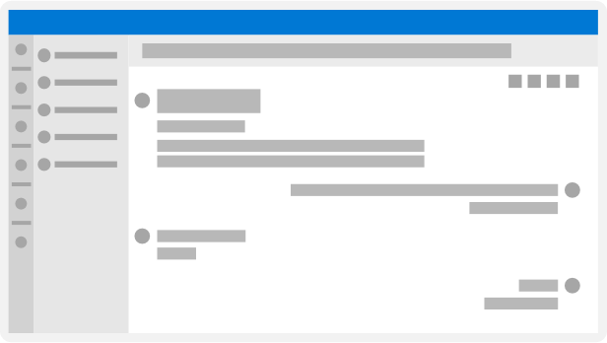





Why is data security so difficult?
Shared storage
3
Messages
Cloud apps
8
7
18
21
Emails
Organizations must
secure data in…
Devices
Notes:
Talk track:
Why is data security so difficult? Organizations need to secure data in multiple channels, including emails, messages, shared storage, cloud apps, and devices, on top of managing a fragmented solution landscape we mentioned in the previous slide.

Slide 16

Your data footprint is growing rapidly
Notes:
Talk track:
Data is like the oxygen of digital transformation. As organizations and individuals rely more and more on data, the creation and consumption of data are constantly growing. Can you imagine that people created 2.5 quintillion bytes of data and sent 333.2 billion emails every day? Every organization is experiencing the explosion of data growth and needs to rethink the approach they manage and protect data.
Source: How Much Data Is Created Every Day in 2023? (techjury.net)

Slide 17










Data security incidents can happen anytime, anywhere
1
2
3
The organization has no visibility into the document
Copied to a USB and then uploaded to a personal Dropbox
Shares the file copy with a few colleagues
Document is at risk of misuse
Document is maliciously stolen
Document gets accidentally exfiltrated by a negligent user
Notes:
Talk track:
With more than 300 million people working remotely all over the world and collaborating across multiple environments and devices, data security incidents can happen anytime anywhere. There are three primary scenarios for data security incidents: 1) If your organization doesn't have visibility into it's data – the data is at risk of misuse (exfiltration, exposure, etc.). 2) If a user has malicious intent and is trying to exfiltrate the data and 3) If a user inadvertantly takes a sensitive document and makes it visible.

Slide 18














Organizations need to…
Protect sensitive data wherever it lives throughout its lifecycle
Understand user activity context around the data and identify risks
Prevent data from unauthorized use across apps, services, and devices
Notes:
Talk track:
To help address the data security challenges, organizations need to implement multiple controls, including preventing data from unauthorized use across workloads, protect sensitive data wherever it lives throughout its lifecycle, and understand user activity context around the data. You need to do all three to fortify your data security strategy, and Microsoft can help.

Slide 19
Microsoft’s approach to data security
Protect sensitive data
Prevent data loss
Manage insider risks
Support for multi-cloud, hybrid, SaaS data | Partner ecosystem
Notes:
Talk track:
As organizations think about protecting their most important asset, their data, they ultimately need to create a defense in depth approach around it. There are three components to this strategy, but it is important to keep in mind that you don’t need to do these in any particular order. This strategy should be tailored to your own organization’s unique needs. Let’s break that down. (Internal note: You can advance the slides to each node for the rest of the talk track if you are presenting the whole deck)
Let’s start with protecting sensitive data. It is important to understand and discover sensitive data within your organization. You need solutions that provide unparalleled visibility into your entire data estate, whether on-prem, hybrid, or multicloud. Microsoft Purview offers a single pane of glass which enables you to view and manage your data from one place, improving your team’s efficacy for data security. You can see the volume, type, and location of sensitive information in your data estate. Discovering the data is beneficial when you can put protection policies in place to keep that data safe. To protect you at this line of defense, we offer solutions to help you classify and label your data and apply productions such as RMS, encryption and more.
Data doesn’t move itself; people move data. With all data in organizations, you need to understand the user context and intent around the data to effectively protect it with the right policy. This next layer of defense takes into account user context to identify potential data risks and/or risky activities that may lead to data security incidents, enabling security teams to quickly take mitigating action. Since data loss is usually caused by internal actors, organizations need to take a holistic approach to managing insider risk, which brings together the right people, processes, training and tools.
The last layer of defense in this integrated in-depth approach is to prevent data loss or unauthorized use of data. Over 85% of organizations do not feel confident they can detect and prevent loss of sensitive data. Organizations need a way to balance protection and productivity, without compromising either. It’s critical to ensure the proper access controls are in place and policies are set to prevent actions like improperly saving, storing, or printing sensitive data.
And of course, underlying everything here, is a strong ecosystem of partners, third party apps/platforms and clouds, as we know your data isn’t just within the Microsoft environments. Our aim is to make sure these layers are put in place to protect your data, no matter where it is.
it doesn’t matter where you embark on this journey. Each layer makes your data security stronger. So, build out what is most critical to you right now as you look to develop your longer-term strategy. These components create an integrated and holistic data security strategy, helping you to keep your organization’s data safe, wherever it lives

Slide 20

Protect sensitive data
Microsoft Purview Information Protection
Discover and classify data at scale using automation and machine-learning
Safeguard data throughout its lifecycle with labeling and encryption built into productivity tools
Extend the protection experience across environments to protect data wherever it lives
Notes:
Talk track:
Let’s start with protecting sensitive data. Microsoft Purview Information Protection provides automation and machine-learning to help discover and classify data at scale, so you can know the volume, type, and location of sensitive information in your data estate in a single pane of glass. To protect your data at this line of defense, the solution also helps safeguard data throughout its lifecycle with persistent labeling and encryption built into productivity tools. Lastly, as we want to help you protect data in this modern workplace where users work from multiple environments, the visibility and protection of sensitive information are extended across your entire data estate, whether on-prem, hybrid, or cloud.

Slide 21

Manage insider risks
Microsoft Purview
Insider Risk Management
Protect user trust and build a holistic insider risk program with pseudonymization and strong privacy controls
Identify hidden risks with hundreds of built-in machine-learning models and indicators, requiring no endpoint agents.
Expedite mitigation with enriched investigations and adaptive protection that enforce controls dynamically.
Notes:
Talk track:
Data doesn’t move itself; people move data. With all the sensitive data in your organization, you need to understand the user context and intent around the data to effectively protect it with the right policy. This next layer of defense takes into account user context to identify potential data risks and/or risky activities that may lead to data security incidents, enabling security teams to quickly take mitigating action.
Microsoft Purview Insider Risk Management is a privacy-first solution that help you manage insider risks while protecting user trust with pseudonymization on by default and other strong privacy controls including RBAC, explicit user opt-in, and audit logs.
With hundreds of built-in machine learning models and indicators, Insider Risk Management can help you correlate signals from various first- and third-party systems to identify hidden risks. One of the powerful models here is sequence detection. Most of the time, one single event, such as copying files to a USB, might not indicate good or bad intention. But if a user renamed the files to make it appear less sensitive prior to copy it to a USB, and then delete the files afterwards, that might show a user intent to evade detection of data exfiltration. With Insider Risk Management, security teams can detect this type of connected activities. This is just one example of the powerful ML models the solution provides. Along with other built-in ML models, Insider Risk Management helps identify the most critical risks for security teams to investigate. Best of all is that it requires no agents!
Lastly, Insider Risk Management provides enriched and interactive investigation tools to help security teams dive deeper into each alert or case. With the right permissions, admins can see the activity logs plotted on a risk score and timeline chart, see the content related to each activity in their native views, and get forensic evidence that help gain visual insights into user activities that may lead to security incidents. Insider Risk Management also enables Adaptive Protection that can enforce effective controls on high-risk users dynamically to contain insider incidents early on.

Slide 22

Prevent data loss
Microsoft Purview
Data Loss Prevention
Cloud native with built-in protection in Microsoft 365 apps, services, and windows endpoints - no on-premise infrastructure or agents needed
Balance protection and productivity with granular policy controls and manage DLP policies all workloads from a single location
Leverage classification and user activity insights to better inform DLP polices and benefit from an integrated incident management
Notes:
Talk track:
Equally important in to ensure that your egress channels such as applications, services, and devices prevent sensitive data from exfiltration and unauthorized use. Over 85% of organizations do not feel confident they can detect and prevent loss of sensitive data. Organizations need a way to balance protection and productivity, without compromising either. It’s critical to ensure the proper access controls are in place and policies are set to prevent actions like improperly saving, storing, or printing sensitive data.
Microsoft’s DLP solution is a comprehensive solution that works across different environments and services where sensitive data is stored, used or shared, including platforms native to Microsoft – as well as and non-Microsoft services and apps. Microsoft’s DLP solution helps organizations consolidate the several individual solutions and save costs.
Microsoft Purview DLP is:
Cloud native, which means that there is no need to deploy and maintain any on-premises infrastructure. Microsoft Purview DLP has protection built-in to Microsoft 365 cloud services such as Exchange Online, SharePoint Online, OneDrive for Business, and Teams, Office apps, and on endpoint devices with Windows and Microsoft Edge. DLP controls can also be extended to macOS endpoints and Chrome and Firefox browser, and various cloud apps such as Dropbox, Box, Google Drive, and others through the integration with Microsoft Defender for Cloud Apps.
Unified, as it allows you to create, deploy, manage your DLP policies across all workloads from a single location in Microsoft Purview compliance portal. You can balance protection and productivity by leveraging granular policies policy controls and restrict certain actions in specific situations while allowing others. Ex – you can allow printing on corporate printers and block it on personally owned printers.
Integrated, because Microsoft’s DLP solution is built from a common framework, DLP policies are consistently applied to all environments. Because DLP leverages Microsoft Purview Information Protection, you can use the built-in policy templates and classifiers to create and define DLP policies quickly. You can also make your DLP policies dynamic by leveraging the security risks levels of your users from Insider Risk Management and automatically adjusting the strength of protection
We are also focused on ensuring that the DLP solution remains consistently easy to deploy and manage across different workloads. We have built a streamlined experience for administrators, from the time they identify sensitive data and apply sensitivity labels, to configuring policies that govern the use of sensitive data. Additionally, information workers have an integrated experience that is intuitive, guided and not disruptive in their day-to-day tasks.
And if you are using Symantec DLP, we provide an easy way to migrate your current DLP policies using our DLP migration assistant. The tool analyzes your current Symantec policies and converts them into equivalent Microsoft Purview DLP policies for supported workloads – Exchange, SharePoint, OneDrive, Teams, and endpoint.

Slide 23
Fortify data security with Microsoft Purview
Information Protection
Data Loss Prevention
Insider Risk Management
Support for multi-cloud, hybrid, SaaS data | Partner ecosystem
Notes:
Talk track:
Microsoft Purview offers Information Protection, Insider Risk Management, and Data Loss Prevention on one unified platform that helps organization fortify data security effectively, so you can develop a defense-in-depth approach when it comes to protecting your sensitive data.

Slide 24
Fortify data security with an integrated approach
Information Protection
Discover and auto-classify data and prevent it from unauthorized use across apps, services, and devices
Understand the user intent and context around sensitive data to identify the most critical risks
Enable Adaptive Protection to assign appropriate DLP policies to high-risk users
Data Loss Prevention
Insider Risk Management
Support for multi-cloud, hybrid, SaaS data | Partner ecosystem
Notes:
Talk track:
You need all three defenses of protection to effectively secure data from potential data security incidents and they work better together with reinforced synergy across the platform. For example, if you use Information Protection and Data Loss Prevention together, you are able to discover and auto-classify the data and prevent it from unauthorized use. Using Information Protection and Insider Risk Management together, you can understand the user intent around sensitive data to identify the most critical data risks in your organization. Another example is if you use Insider Risk Management and Data Loss Prevention, then you can enable Adaptive Protection which assign appropriate DLP policies based on user’s risk levels. We will explain more about Adaptive Protection in the next slide. If you use all three products, then you can fortify your data security with a defense-in-depth approach.

Slide 25
Enable Adaptive Protection with Microsoft Purview
Insider Risk Management
Detect risky users and assign risk levels
Data Loss Prevention
Dynamically apply preventative controls
Optimize data protection automatically
Context-aware detection
Identify the most critical risks with ML-driven analysis of both content and user activities
Dynamic controls
Enforce effective controls on high-risk users while others maintain productivity
Automated mitigation
Minimize the impact of potential data security incidents and reduce admin overhead
DLP Policy 1
Elevated risk
Block
Moderate risk
DLP Policy 2
Block with override
DLP Policy 3
Minor risk
Policy tips
Notes:
Talk track:
We are excited to share the availability of Adaptive Protection, a new capability of Microsoft Purview, which helps you optimize data protection automatically.
In the past, admins might receive many alerts when files containing sensitive information were shared, transferred, copied, or printed. It could be overwhelming or resources-draining to triage and address all the alerts while there is limited support to prioritize them. With Adaptive Protection, admins can continuously detect the most critical risks with ML-driven analysis on both content and users, identifying sensitive data in motion performed by risky users, such as an employee who just submitted a resignation. (Click) Remember, data doesn’t move itself; people move data. By understanding the risk indicators of the user interacting with the data, admins can get more context-aware detection and reduce the overhead of reviewing an overwhelming number of alerts.
When you treat users with a static data protection policy, most of the time, the control would either be too loose that it didn’t help remediate data loss risks or too strict about blocking users from working productively. (Click) Adaptive Protection can change that by automatically adjusting the right level of remediation controls based on the risks detected, so high-risk users would be scoped in a stricter control while low-risk users can work as usual. And it’s constantly adjusting, so the control could be dialed up or down when the users’ intent or behaviors change. The more precise remediation enables effective control enforcement while maintaining productivity.
Instead of treating risks separately in various solutions, Adaptive Protection brings signals and controls together across solutions. (Click) Here, you see how the risk indicators from Insider Risk Management and the data classification insights in DLP can help build a 1+1 > 3 protection. Organizations can take a defense-in-depth approach to prevent data loss, investigate insider risks, and leverage the integration between IRM and DLP to apply the right level of controls while maintaining productivity.

Slide 26



Why choose Microsoft Purview
Simple
Easy to get started with built-in protection, no additional agents and an optimal user experience
Integrated
Single portal for management and secure collaboration, built into productivity tools
Intelligent
Automate data security with ML-driven data classification and dynamic risk detection
Notes:
Talk track:
There are many data protection vendors in the industry, why is Microsoft Purview uniquely positioned to help you build a better data security strategy? Here are three reasons:
First, it's easy to get started and do not require you to go deploy agents. For example, with Information Protection you don't need to train your classifiers – and can leverage auto-classification capabilities. With Insider Risk, you can run an Analytics report to identify trends and risks before even implementing a policy. And with Data Loss Prevention, you can leverage audit mode in a few simple clicks!
Second, Microsoft Purview products not only integrate across its platform to drive synergy, but also integrate with the most commonly-used productivity tools, such as Teams, Exchange, SharePoint, and OneDrive, so users get appropriate nudges as needed and can take actions to help protect data responsibly.
Lastly, Microsoft Purview offers built-in machine learnings capabilities to help discovery sensitive data, classify data, and detect the most critical risks around the data, as we mentioned in the previous slides.

Slide 27
Improve risk and compliance posture Identify data risks and manage regulatory compliance requirements

Slide 28

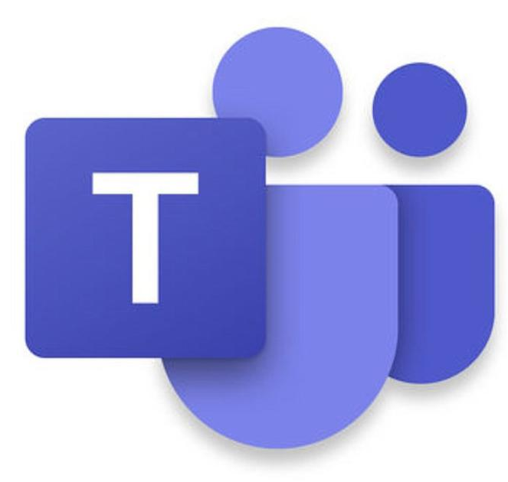

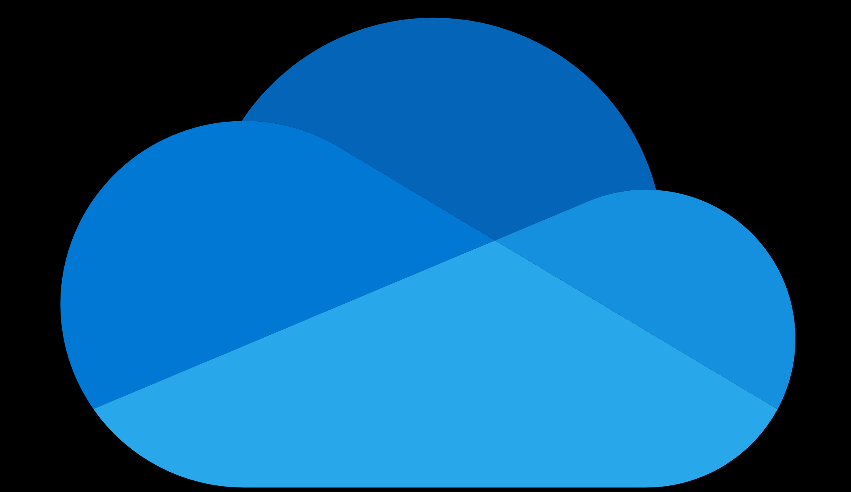






Microsoft Purview Data Lifecycle Management Classify and govern data at scale
Retain or delete data and manage records where users collaborate to manage risk and prevent productivity loss
Demonstrate compliance with label analytics insights, defensible disposal, and rich audit trails
Manage non-Microsoft data import with pre-built data connectors*
Microsoft 365
Non-
Microsoft data
Powered by an intelligent platform
*Pre-built data connectors include connectors built by Microsoft and by partners – Veritas, Telemessage, CellTrust and 17a-4 LLC. Except for Veritas, Telemessage, CellTrust and 17a-4 LLC, Microsoft does not have direct relationships with the data source companies in bringing these data connectors to the platform.
Notes:
Talk track:
And finally, you can now put retention and deletion policies in place to help you manage information lifecycle and meet recordkeeping obligations for data in Microsoft 365 and beyond.
Microsoft Information Governance helps classify and govern data at scale with the following capabilities:
In-place management: On average, organizations are wrestling with five different content systems and repositories. Duplicate information across platforms not only causes productivity loss but also increases risks. In-place management enables companies to retain information and manage records where data is created to prevent productivity loss and reduce operational and legal risks.
Automated policy: The volume of information is expected to grow 4.5 times over the next two years. Relying on manual classification is ineffective since users usually care the most about the value of the information, less about the risks it generates. It’s challenging to hold them accountable to classify and manage information accurately. By automating information governance, companies can leverage various auto-classification capabilities such as file properties (e.g., Content Type defined in SPO), pattern recognition, and machine-learning classifiers to classify and govern data at scale.
Defensible process: Multiple regulations, such as SEC 17a-4 and FINRA, require companies to meet stringent information governance requirements like record immutability. Companies also need to demonstrate compliance by proving they follow a defensible process to dispose of content. Microsoft 365 provides transparent insights on how data is classified to help you audit and finetune classification and policies. Moreover, the records management capabilities within Microsoft Information Governance can help companies follow a defensible process to retain and dispose of information with proof of disposals that can be kept for 7 years, disposition reviews, and rich audit trails.
Pre-built data connectors: To help companies leverage the capabilities above to govern data beyond Microsoft cloud, we provide pre-built data connectors for social media, text messages, chats, and collaboration data. Microsoft not only builds its own connectors but also works with hand-picked partners like TeleMessage and Globanet to enable ongoing and high-fidelity data import. In addition to the pre-built ones, customers and partners can build their own custom connectors to continuously ingest data into Microsoft 365.
You can leverage these four key capabilities to govern both the general and high-value information across various data sources:
General information governance: Retain only what you need and delete what you don’t to reduce risks and liability.
High-value information management: Classify, retain, review, dispose, and manage records to meet recordkeeping obligations.

Slide 29
Microsoft Purview Compliance Manager
Intuitive end-to-end compliance management
Manage end-to-end compliance from easy onboarding to control implementation
Configure out of the box assessments to meet your requirements across all assets
Simplify compliance with continuous assessments, automated control mapping, and a compliance score
Compliance Manager
Your compliance score:
65%
1254/2000 points achieved
Notes:
Talk track:
With Microsoft Purview Compliance Manager, you can now continuously assess and monitor data protection controls, get clear guidance on how to improve your score and thus reduce compliance risks, and leverage the built-in control mapping to scale your compliance effort across global, industrial, and regional standards.
Intuitive management: The complexity of regulations makes it challenging for organizations and IT administrators to know specific actions they can take to meet their compliance requirements. Compliance Manager provides easy, guided onboarding and supports twenty four languages. With simple design that works out of box, IT admins and Compliance / Audit Officers can quickly collaborate to address compliance. With Compliance Manager, you don’t need to be an expert in complex regulations like the General Data Protection Regulation (GDPR) to know the actions you can take to improve compliance effectiveness. Compliance Manager now combines the functionality of compliance score and the existing Compliance Manager solutions, making it a single portal for end-to-end compliance management.
Scalable assessments: Compliance Manager provides access to a vast library of 150+ assessment templates – from global regulations such as the GDPR, PCI-DSS, COBIT 5, to regional assessments such as Brazil’s LGPD data protection law and Malaysia’s Personnel Data Protection Act. Industry-specific assessments such as HITRUST and Cybersecurity Maturity Model Certification (CMMC) are also covered. Compliance Manager now provides the ability to quickly customize these assessments to meet your unique business requirements. With the custom assessments feature, you can manage compliance across your assets in one location by bringing your own assessments into Compliance Manager. For example, if you are currently tracking compliance of your SAP data in an Excel file, you can bring that into Compliance Manager.
Built-in automation: Compliance management can be tedious, and organizations often find it difficult to know their degree of compliance with specific regulations. Translating ever-changing regulatory requirements into specific actions and controls is also challenging and not all organizations have the resources to do this accurately. Point-in-time assessments (e.g., for quarterly/semi-annual/annual audits) also mean that organizations tend to have ‘blind spots’ between these assessment windows. To help you with these challenges, Compliance Manager comes built-in with the following capabilities: compliance score, control mapping, continuous regulatory updates, and continuous assessments
Microsoft Purview Compliance Manager measures your progress towards completing recommended actions that help reduce risks around data protection and regulatory standards.

Slide 30






Microsoft Purview Communication Compliance
Quickly identify and act on code-of-conduct policy violations
Intelligent customizable playbooks detect violations across Teams, Exchange, and third-party content
Flexible remediation workflows enable quick action on violations, like remove incriminating messages on Teams
Identify and investigate communications risks while maintaining end-user privacy
Notes:
Talk Track:
Intelligent Customizable playbooks:
There are four pre-configured templates within Communication Compliance: regulatory compliance, offensive language, sensitive information types, conflicts of interest.
These are available across first- and third-party content, in 8 languages, with the ability to customize policies.
ML models continue to learn with trainable classifiers including gory, racy, adult images, harassment, discrimination, threats, profanity.
Remediation workflows:
Collaborative and easy-to-navigate
Identify risk communication with keyword highlighting and prioritization through past user behavior
Ability to send notification to employee, escalate the case for investigation, remove message from Teams channels
Able to provide feedback to improve the model
Privacy built in:
Rules-based access controls
Admin opt in of users/reviews
Pseudonymization and audit trails to scan behavior

Slide 31
Microsoft Purview eDiscovery
Discover, preserve, collect, process, cull, and analyze your data in place
Preserve content by custodian, send hold notifications, and track acknowledgements
Review and manage static sets of documents within a case, that can be independently searched, analyzed, shared, and acted upon
Near duplicate detection, email threading, themes, and ML models to identify potential high value content and make the review process more efficient
Notes:
Talk Track:
We put significant investments in eDiscovery. We built whole new stack –from ground up.
​
Custodian Management
It’s looking to simplify the process. For example, a typical case requires hunting down mailbox addresses and SharePoint urls in order to use scripts to find out the addresses, plus give the export of the scripts. Now, with eDiscovery, you have the ability to just tell us who has been escalated. Our solution then goes in the background and maps the content for you – these are the sources in play that you can hold to get started on a case. ​
Review
Before a user exports, we wanted to provide a view of the content in review. These review tools help with analytics for culling decisions (to show related content), near duplicate detection, email threading, and redaction of content.
​
Deep Indexing
Microsoft is using a search that is tuned for performance – finding the most relevant content quickly becomes critical. Because we tune it for speed, we give it rules to look for specific items (and skip specific items that may take too long). For example, if you put a file with too many attachments, this would be skipped to optimize for speed. In our new stack, we will look at that content before we search. For example, if Jane is the custodian, looking at her content will pick up any partially and unindexed content. Jane then has the ability to index that content, so that when she searches for something specific, she is able to access primary and secondary indexes. ​
​
​
​

Slide 32
Microsoft Purview Audit Power your forensic and compliance investigations
Tap into additional events that are important for forensic investigations (e.g. mail items accessed, mail send, user search)
Preserve audit logs for up to a year, with option for 10-year retention add-on
High bandwidth access to data with ~2x the baseline
Notes:
Talk Track:
There are 3 key capabilities we offer customers in Audit to help with their regulatory, legal and compliance obligations.
The first are additional audit events that help with forensic investigations. Earlier this year we delivered new events that helps investigators understand if mail items were accessed through the mail sync and mail bind operation. This is extremely helpful to organizations with regulatory obligations that require breach notifications, because now they can scope mail items that may have been compromised to reduce fines and penalties.
Another key area is around retaining audit logs. According to the latest Ponemon research, it takes roughly 6 months to detect a data breach and organizations need a way to go back to the audit logs to conduct forensic investigations. Advanced Audit extends audit log retention from 90 days to 6 months. And new to Audit – optionally add 10-year retention for highly regulatory customers that need to keep audit log data for longer.
And lastly, for those using activity API, Audit provides 2 times the bandwidth compared to other customers – which is valuable especially if customers are using audit data in 3rd party solutions.

Slide 33
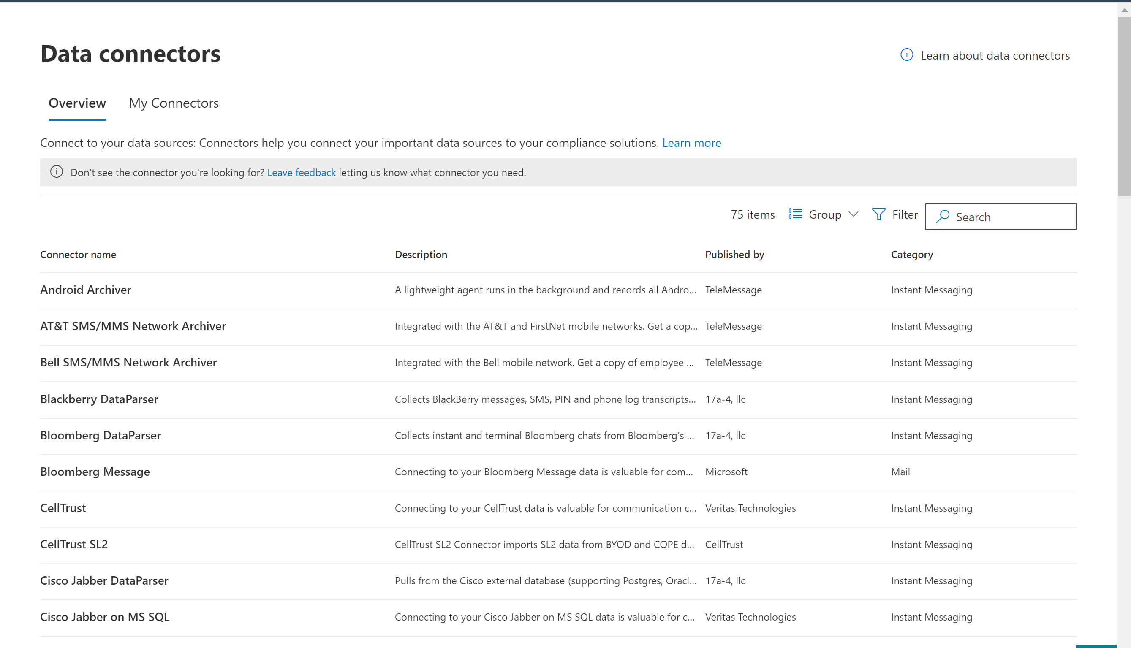
Microsoft Purview Data Connectors
Ingest non-Microsoft data and benefit from Microsoft Purview solutions
One catalog for all connectors built by Microsoft and partners (TeleMessage,Veritas,17a-4,CellTrust) in one place
Simplified deployment and monitoring with few clicks to setup data import for most connectors*
Hi-fidelity data ingestion available for Purview solutions
73 built-in connectors including Bloomberg Message, Slack eDiscovery, Zoom Meetings, Webex, Twitter etc.
*Pre-built data connectors include connectors built by Microsoft and by partners – Veritas, Telemessage, CellTrust and 17a-4 LLC. Except for Veritas, Telemessage, CellTrust and 17a-4 LLC, Microsoft does not have direct relationships with the data source companies in bringing these data connectors to the platform.

Slide 34




Microsoft Purview ecosystem Extend, integrate and automate compliance solutions beyond Microsoft 365
High fidelity multi-cloud data ingestion from 70+ sources, benefitting from multiple Microsoft Purview solutions
In-place multi-cloud data classification covering 35+ sources
APIs to integrate and automate Microsoft Purview solutions with existing applications and services (e.g. McAfee, Netskope, Relativity)
Identify and protect sensitive information that is unique to your organizations using ML and built-in customizations
Built-in workflow automation with Power Automate
Notes:
Talk track – tie it back to the opening statement (make it easy for customers)
----------------------------------
- : Vision Page : -
What are we trying to achieve here?
Our value can be extended to third-parties
Customers can access their data using APIs
Partners can use APIs to integrate
Service providers to manage at scale

Slide 35



How to get started with Microsoft Purview
Learn more on our webpage
aka.ms/microsoftpurview
Try our solutions for free
Compliance trial
Governance trial
Contact sales
Reach out to your account executive for more information
Notes:
Key slide takeaway: Follow these three important steps to secure your remote workforce:
Enabling remote access to apps
Managing devices and apps
Protecting corporate resources.
Main points to cover:
At Microsoft, we are committed to your success when it comes to securing remote work.
We have been working with many organizations across the globe over the past months alongside our productivity and security experts to provide practical remote worker guidance and recommendations.
We have identified three areas where you can make quick progress to make sure your people are productive and secure when working remotely:
Enable remote access to all of your apps – that includes on-premises and cloud apps.
Manage your devices and apps effectively, whether that’s protecting BYO or administering ongoing patches and updates.
Protect your corporate resources from threats and keep your data protected.
Presenter note: Take a moment to understand your customer’s most acute remote work needs. This will allow you to create a more customized discussion and to pinpoint the right sections to use during your discussion.

Slide 36

Identity
Security
Compliance
Privacy
Management
Microsoft Purview
Microsoft Confidential – For Internal Use Only
Notes:
ALYM
The new brand architecture for the Compliance portfolio aligns to the Security market and product strategy and sits under our Microsoft Security portfolio of solutions.

Slide 37
Industry-leading security from Microsoft
43T¹
Analyzing
Threat signals daily
50% increase
32B¹ Blocking
email threats annually
$20B1
Monitoring
140+3
in the next 5 years
Investing to improve and share knowledge, gain insights, and combat cybercrime
Threat groups
40+3
60%
15K1
785K²
Nation state-groups
Keeping you secure, while saving you time and resources
customers rely on Microsoft for their multicloud, multiplatform infrastructure security
Serving billions of global customers, learning and predicting what’s next
Up to savings, on average, over multi-vendor security solutions
partners in security ecosystem
Trusted globally, protecting organizations’ multi-Cloud and multi-platform infrastructures
Earnings Press Release, FY22 Q4. July 26, 2022, Microsoft Investor Relations
“Microsoft Digital Defense Report”. October 2021, Microsoft Security
Earnings Press Release, FY22 Q2. December 16, 2021, Microsoft Investor Relations
Notes:
Talk Track:
•“Microsoft serves billions of customers globally, allowing us to aggregate security data from a broad and diverse spectrum of companies, organizations, and consumers. Informed by over 24 trillion security signals per day, our unique position helps us generate a high-fidelity picture of the current state of cybersecurity, including indicators that help us predict what attackers will do next.” --Digital Defense Report Microsoft Oct 2021
•“Microsoft has made significant and ongoing investments to increase and improve the knowledge we derive from our threat signals. These investments deliver the highly synthesized and integrated insights that we share here. Our goal in aggregating these learnings is to help organizations understand the ways in which cybercriminals are continually shifting their modes of attack—and determine the best ways to combat those attacks.” --Digital Defense Report Microsoft Oct 2021
Source of Facts Below:
•Our primary competitive advantage is that we deliver end-to-end solutions spanning security, compliance, identity, device management, and privacy, across clouds and platforms. These solutions are also consistently recognized as a market leader by Gartner, Forrester and IDC.
•43 trillion threat signals each day combined with the intelligence we track by monitoring more than 40 nation-state groups and over 140 threat groups.
•8,500 security defenders dedicated to thwarting advanced cyberattacks. we continue to disrupt cyberattacks and share threat intelligence with governments, as well as other public sector agencies.
•785,000+ customers trust our security solutions and rely on Microsoft to protect their multi-cloud and multi-platform infrastructure.
•We recognize security is a team sport and have over 15,000 partners in our security ecosystem.
Source:
FY22 Q4 - Press Releases - Investor Relations – Microsoft
Microsoft FY22 Q4 Earnings Report
Microsoft Digital Defense Report – Microsoft Security
FY22 Q2 Earnings Call

Slide 38
Discussion

Slide 39
Thank you.

